Slide 1
Holding Company LLC
LLC 1
(Business)
LLC 2
(Rental Property)
LLC 3
(Business #2 or Rental)
What is best business set up?
Cost to have above setup, vs multiple separate LLC’s?
Is there a breakover where the above makes sense? Revenue target etc?
Does the above make paperwork or anything else easier/more streamlined?
Is it possible to move already existing LLC’s into this set up in the future?

Slide 2

Building Things
Fixing things
Being outdoors
Spending time with family in experiences
Zone of Genius
Passion
Project Management
SIMOPS
Operations
Analytical
Process Improvement
Systems/Process Design
Private Money – Friends/Family
BIL – Handyman
BIL – Physical Therapist
SIL – Nurses/Doctor
Friends – Business owners/salesmen
Skills and Experience
Network

Slide 3
Business’s I DON’T Want
Business’s I DO Want
Restaurants
Hotels
Retail Storefronts (upfront costs for inventory), high rents
Consulting firm
Personal brands
Dry cleaners
Electrical
Carpentry
Landscaping / Fencing
Pool Cleaning
Roofing
Accounting
RV Parks / Self Storage
Carwash

Slide 4
My Deal Box
$300k SDE ($200k ok, if need to hire operator)
Semi absentee
Anchorage or Katy/San Antonio
Trades (Electrical/Carpentry/Plumbing/HVAC/Water Wells etc)
Health and wellness (trainers/hair salon/nails/spa)
Interior Design
Real Estate
Farming/Hunting

Slide 5
Basic Prep for Call w/ Owner (Vertical IQ)
What does business do, what issues they face?
Seasonality / Collections / Revenue
Industry News – Things going on Macro Level in industry
Watch video and take notes
Use Prep Sheet

Slide 6
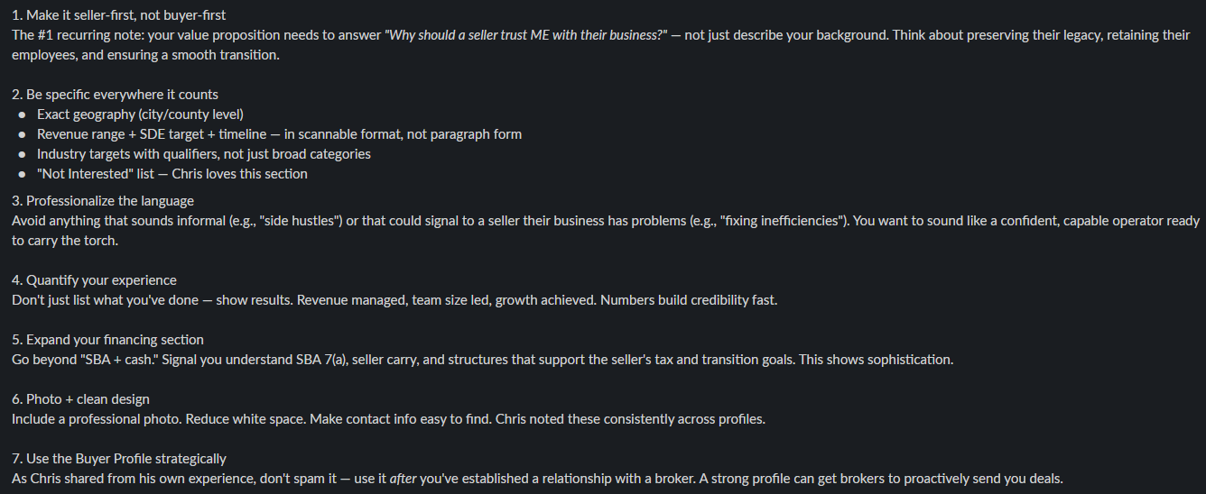
Matthew Smith Buyer Profile

Slide 7
SMB Attorney Questions
Do you have any prior experience in LOI creation or SMB acquisition? Experience is the name of the game, and you’ll want an attorney who knows how to swim with the sharks.
Do you have any client references? A good attorney will have a fan club of satisfied clients who can vouch for their ability to work their legal magic on deals like yours.
Do you have any experience in [your specific industry of the deal]? It’s a big plus if your attorney knows the ins and outs of the industry you’re entering, because they can help you navigate the minefield of regulations like a pro.
What clauses should I add or remove to my LOI to make sure I am covered in the deal? A skilled attorney can cook up an LOI with all the right ingredients to keep your interests safe and sound, without giving away the secret sauce.
How involved are you with the seller and the seller’s attorneys? Your attorney should be a smooth operator when it comes to negotiations, making sure you come out on top without ruffling too many feathers.
How do you prefer to bill? By the hour or retainer? Is it a flat fee, an hourly rate, or some other mystical concoction? No one likes surprises when it comes to the bill, so better to get the money talk out of the way early.
How do you prefer to communicate with clients? Good communication is essential, so make sure your attorney won’t ghost you and will keep you in the loop as the deal unfolds.

Slide 8
